Slide 1

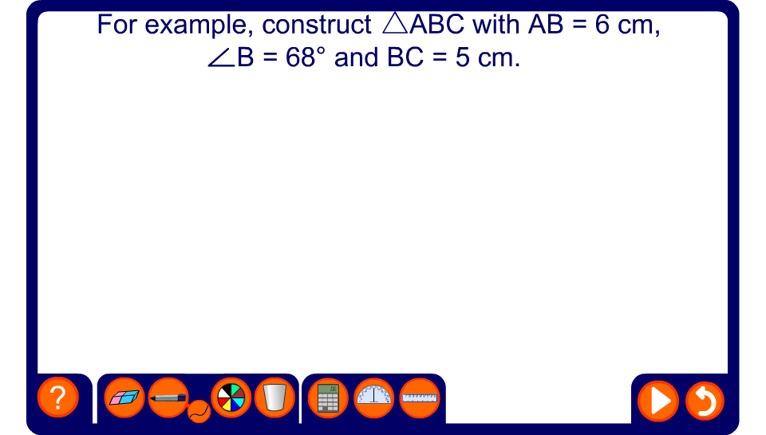


Constructing a triangle given SAS

Slide 2
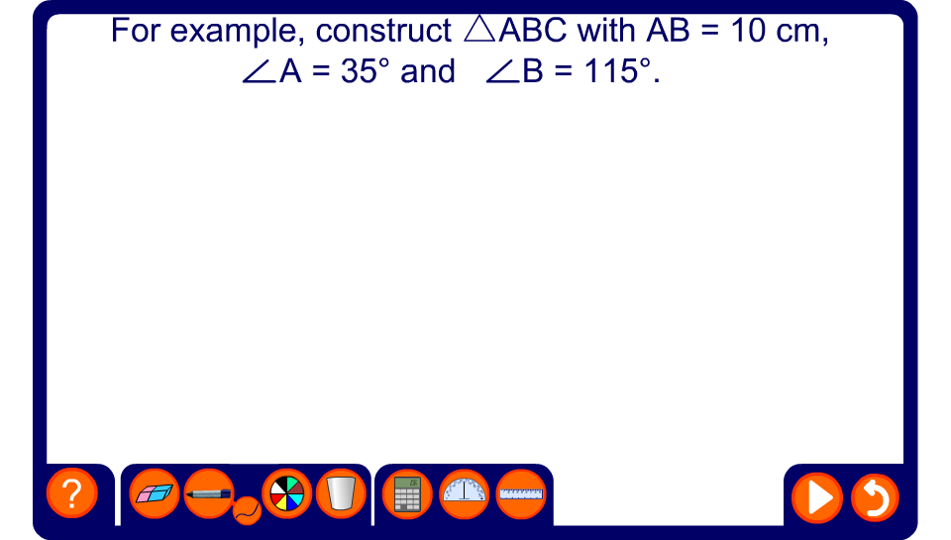
Constructing a triangle given ASA
Notes:
Ask pupils how we could check that this triangle has been constructed correctly.
Establish that we could measure angle C to verify that it measures 30°.
Remind pupils that construction lines should not be rubbed out.

Slide 3

Constructing a triangle given SSS

Slide 4
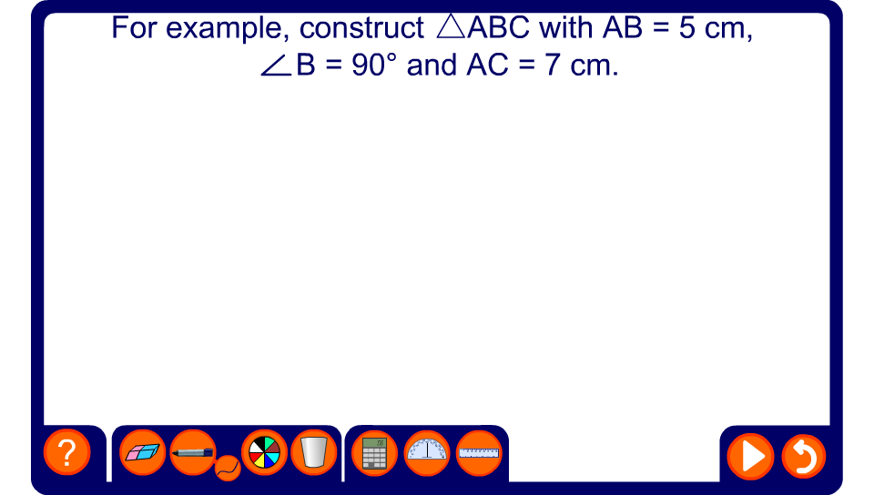
Constructing a triangle given RHS
Notes:
Ask pupils how we know that if angle B is the right-angle side AC must be the hypotenuse.
Stress that the hypotenuse, the longest side in a right-angled triangle, must always be the side opposite the right angle.
Review the construction of a perpendicular from a point on a line on slide 24.

